Slide 1
Suicidal Catalysts

Slide 2
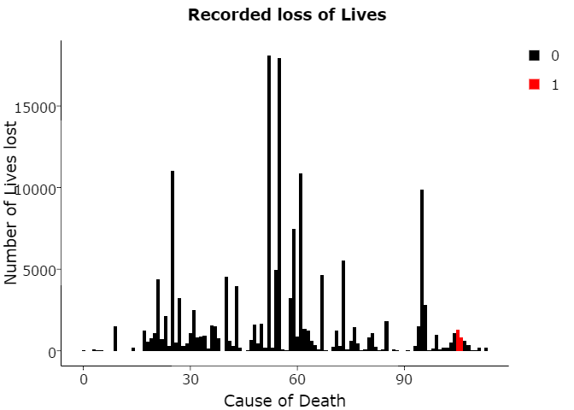
Notes:
National Longitudinal Mortality Survey was a follow up done with a set of population (living in United States) for 11 years time, to observe and record their Health and Lifestyle vitals to study the effects of demographic and socio-economic characteristics on differential in Mortality rates.

Slide 3
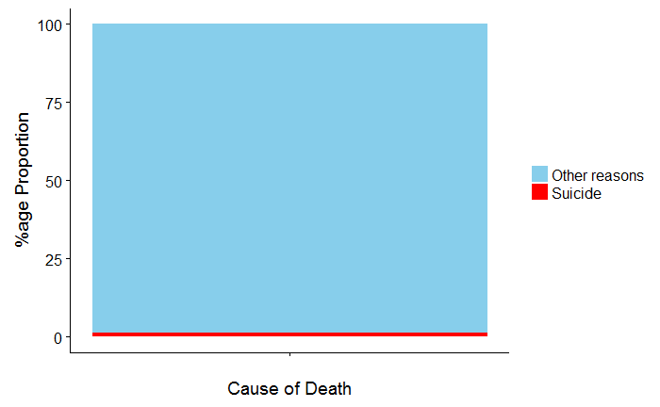
Notes:
The Study had recorded over 113 causes of Death, out of which 1.33% Deaths are because of Suicides.

Slide 4
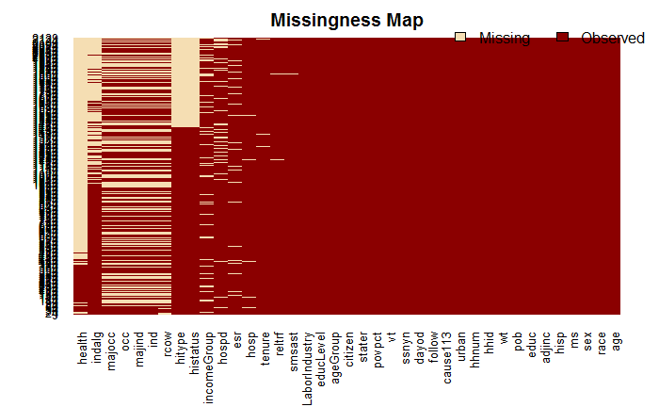
Is each Factor a Catalyst?
Notes:
Out of 39 Factors recorded for each Individual, not each one of them drives towards the Intention of an Individual trying to end his Life. We’ll start with those, which seem to driving the Course.

Slide 5
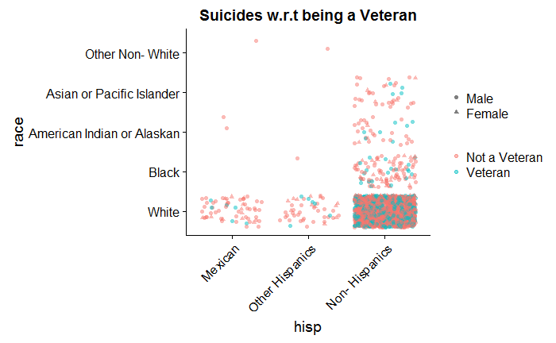
Is being a Veteran a reason?
Notes:
Most of the Suicides have been found by people who are not a member of any Defence Forces.

Slide 6
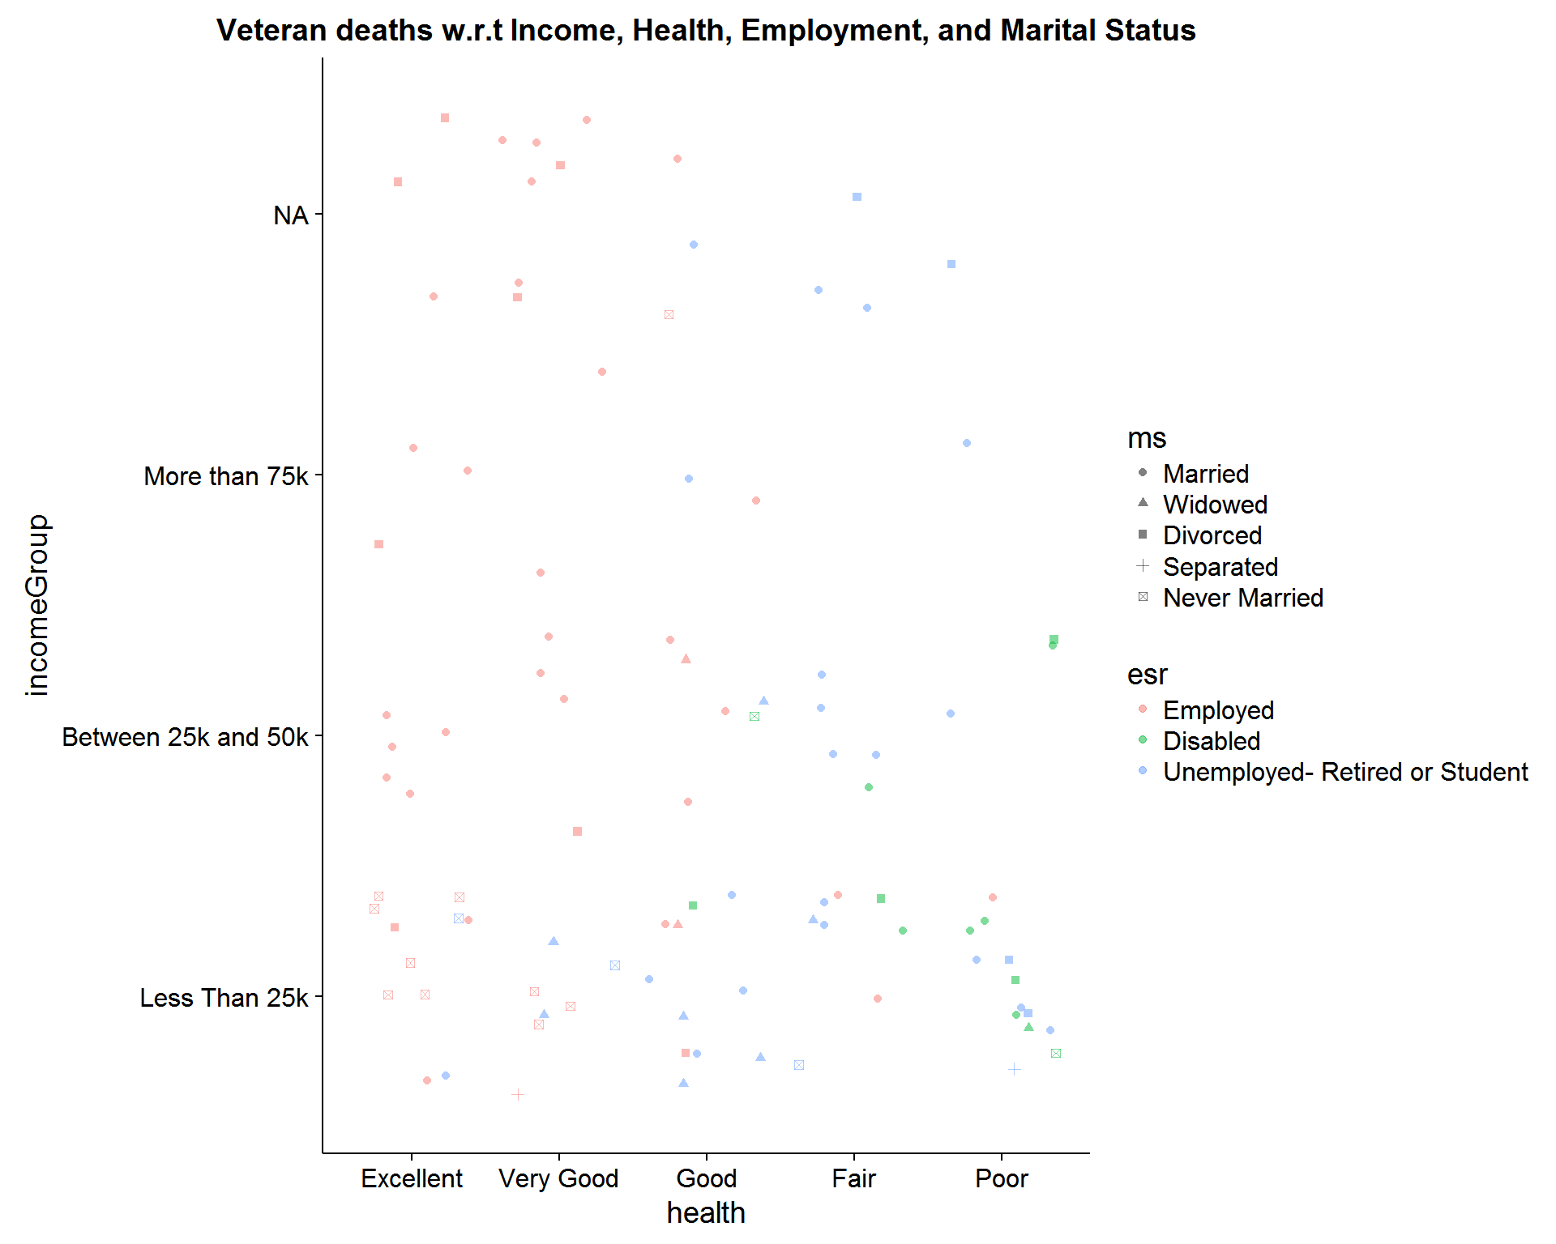
Notes:
People below age of 35 years, having Excellent health, may be facing difficulties with their Intellectual Health.
Can Government authorities do something here by initiaitng a Counselling with the Veterans to help them out?
Disabled people with Poor Health also seem to be conrtibuting towards Suicide.
Their Disability be due to any harm for their participation in any War. Could Goverment authorities taking better Care of them help out from losing their Lives?
People with Income < 25k form the majority.
Could Government increasing their Wages help them out from taking such actions?
Never Married, and Separated are the least amongst Veterans.
Could Marriages, losing the Partner or divorce be a factor leading People into some personal issues, eventually taking a toll on mental Health? If yes, Married/ Divorced/ Widowed people could be focussed to undergo some Counselling sessions to help them out.

Slide 7
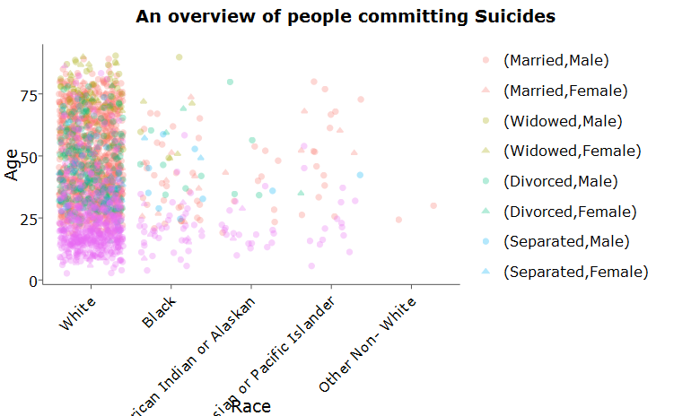
Notes:
Whites have been the most out of Subjects committing Suicides, evenly spread across all Age Groups.
Males are found to be in majority for committing Suicides, with White, Married, and Never Married topping the census. We’ll study the individual contribution of these factors towards deducing the Survivability of any Subject.

Slide 8
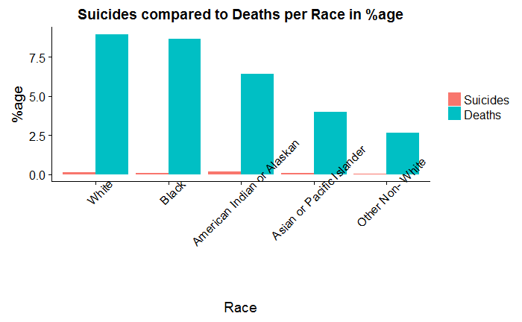
How does Race drive people towards Suicide?
Notes:
The data shows that Whites are the ones committing most of the Suicides, but comparitively there is more %age of the 'American Indian or Alaskan' population committing Suicides.

Slide 9
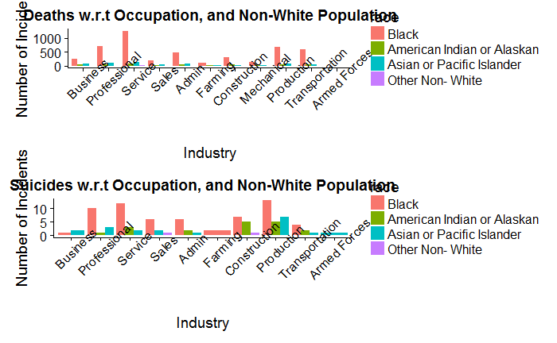
Occupation, Location, Race

Slide 10
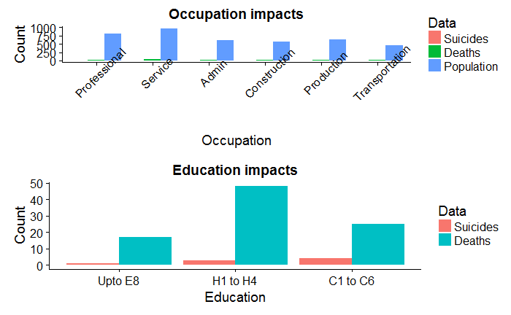
Occupation, Education comparison
Notes:
There are 2 areas- Service, and Production which should be looked into for the maximum number of Deaths, and Suicides, respectively.
American Indian or Alaskan people have committed most of the Suicides in Production, and Construction related Work areas.
However, American Indians or Alaskans did not commit Suicide who worked for Business, Sales, Farming, and Armed Forces. People educated till High School level 4 and having Salary less than 25k are the majority among Subjects.
1. People below age of 35 years, having Excellent health, may be facing difficulties with their Intellectual Health.
Can Government authorities do something here by initiaitng a Counselling with the Veterans to help them out?
2. Disabled people with Poor Health also seem to be conrtibuting towards Suicide.
Their Disability be due to any harm for their participation in any War. Could Goverment authorities taking better Care of them help out from losing their Lives?
3. People with Income < 25k form the majority.
Could Government increasing their Wages help them out from taking such actions?
4. Never Married, and Separated are the least amongst Veterans.
Could Marriages, losing the Partner or divorce be a factor leading People into some personal issues, eventually taking a toll on mental Health?
If yes, Married/ Divorced/ Widowed people could be focussed to undergo some Counselling sessions to help them out.

